Slide 1
Harnessing AI & CV for Efficient Weed Control in Crop fields.
HENRY MUTEGEKI . 2200701327. 2022/HD05/1327U
Link to youtube video: https://youtu.be/umJs4L_yt-4

Slide 2
Overview
Introduction
Methodology
Results and discussion
Conclusion
References

Slide 3
Introduction & Background
World population over 8B & projected to hit 9B by 2050.
Need to put measures that ensure food security and supply.
Crop fields face a challenge of weed control that cause {sun, nutrients, water} competition and thus low yields.
CV & AI algorithms(ML & DL) has shown promise in area of weed identification and detection.
Algorithms such as KNN, NB, SVM, CNNs
Research focus: build accurate models to properly classify crops(cassava, maize, sugarcane) and grass(weeds) in a crop field.

Slide 4
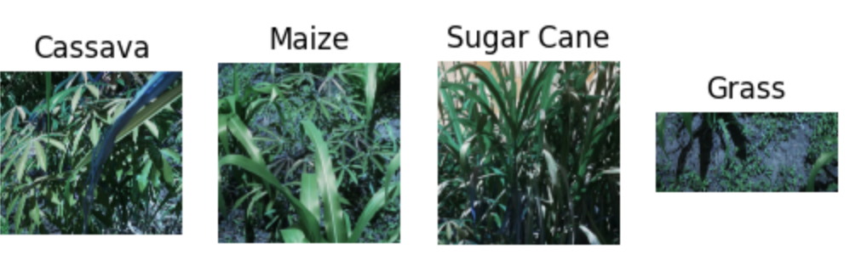
Methodology: Data acquisition
Dataset acquisition: Images were obtained by passing the garden video in a cv2 package “cv2.VideoCapture” and specifying the framerate(0.5).
Saved frames/images were further cropped using snipping tool to boarder out a given crop/grass.
Resultant images (apprx. 1034) were saved in crop specific folders to form a dataset.
Notes:
cv2.VideoCapture

Slide 5
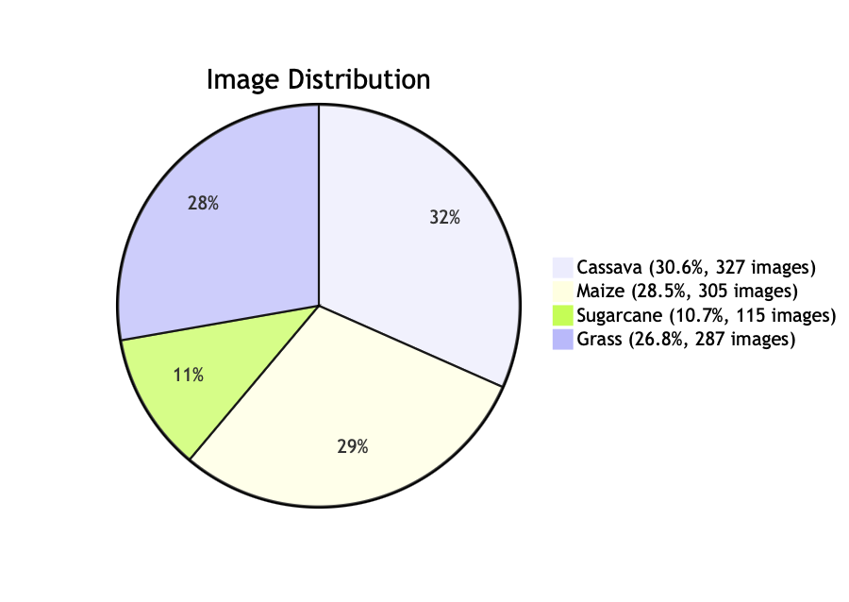
Methodology: Data pre-processing
Image resizing: For the ML models (Naïve Bayes) this is accomplished by resizing it to 500x500. CNN images were resized to 256x256. For standardization & noise reduction.
Rescaling: CNN images were rescaled to fit 1/255.
Data split: NB (80:20), CNN (75:15:10)

Slide 6
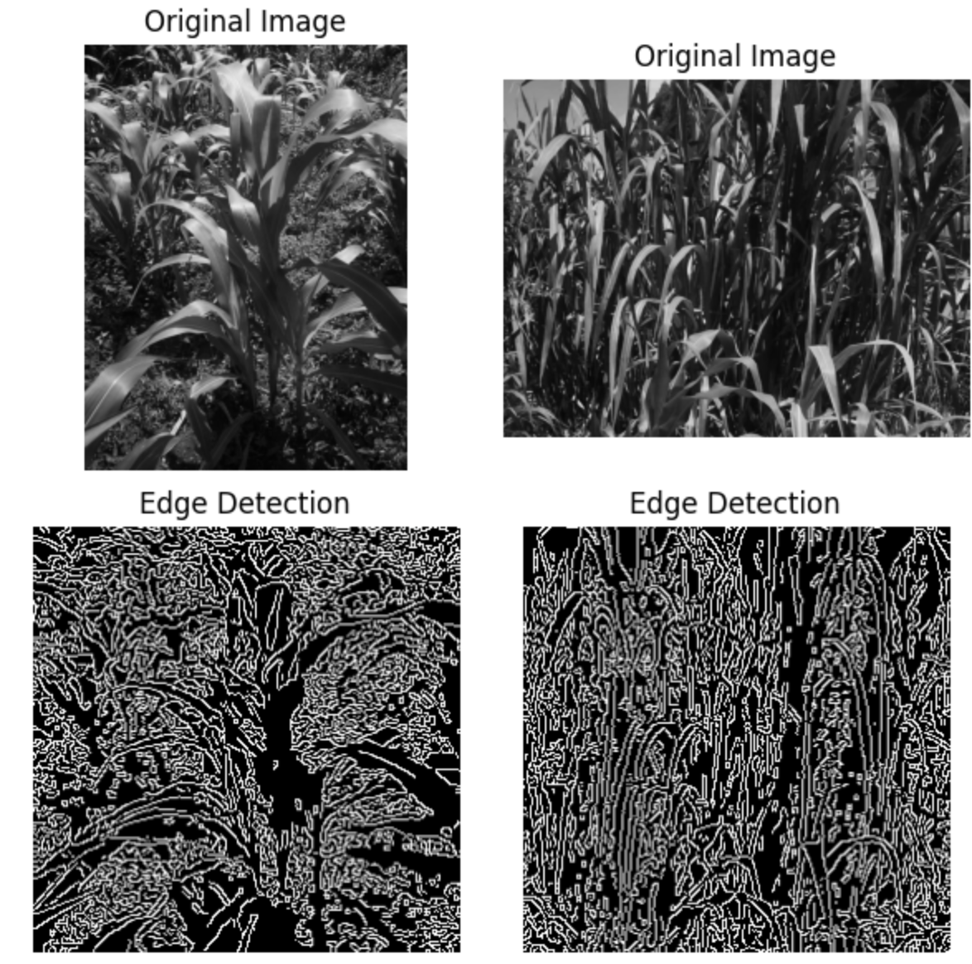
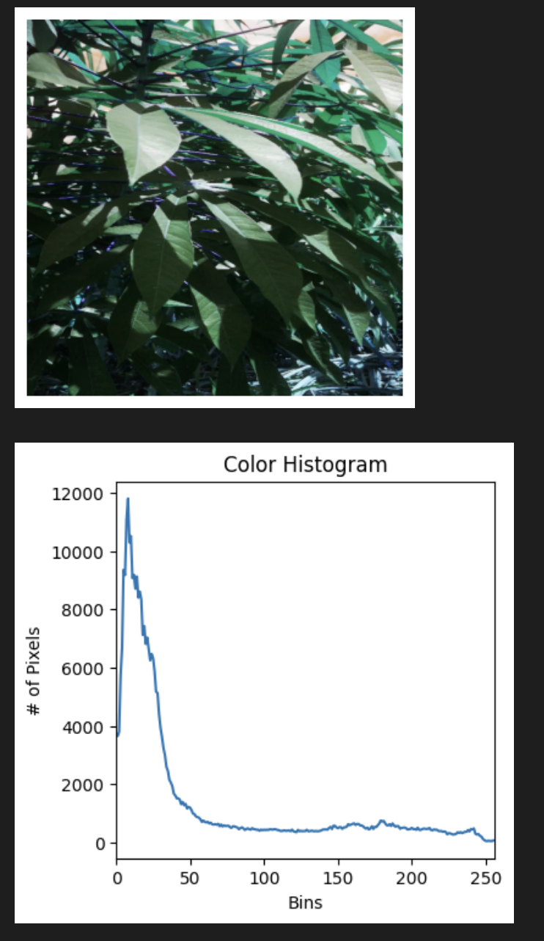
Methodology: Naïve Bayes Modelling
Feature selection & Extraction: Choose edge detection(boundary identification) and color histogram(rep. color distribution efficiently) features for the experiments.
Experiments: Created 3 models that used the features separately, and combined and then evaluated.
Model: Trained Gaussian NB models on features generated.

Slide 7
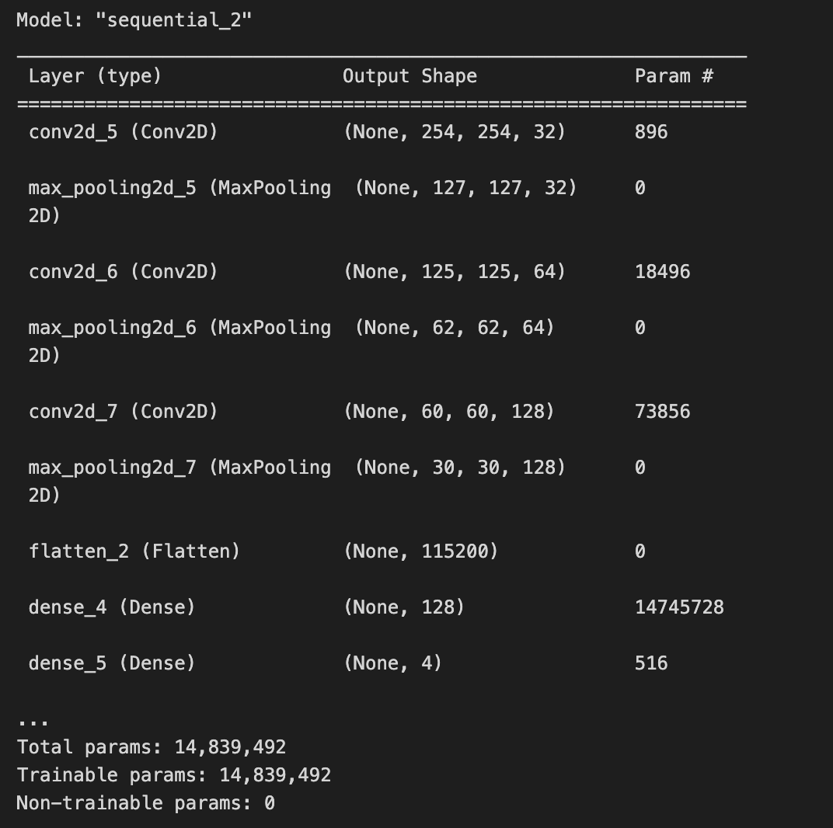
Methodology: CNN Modelling
Keras models built and tuned for efficiency.
Trained for 10 epochs, Batch size 32
Model Architecture:
3 conv 2d layers(scans the input image with its filters to create feature maps )
3 max pool layers(reduces the spatial dimensions of the input (height and width) while preserving the most important features )
1 flattening layer(transforms the 2D matrix data into a 1D vector to prepare it for input into the fully connected layers )
1 dense layers(interpret the features extracted by the preceding layers)
1 dense (softmax) -> Output is 4 probabilities

Slide 8
Methodology: Model Evaluation
Used the following evaluation criteria:
Accuracy
Classification Report {precision, recall, f1 score}
Confusion Matrix

Slide 9
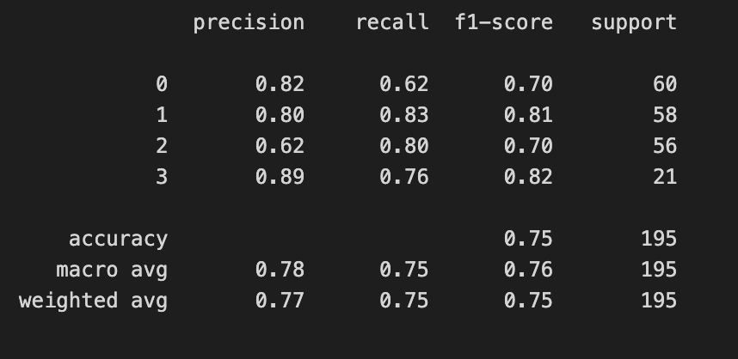
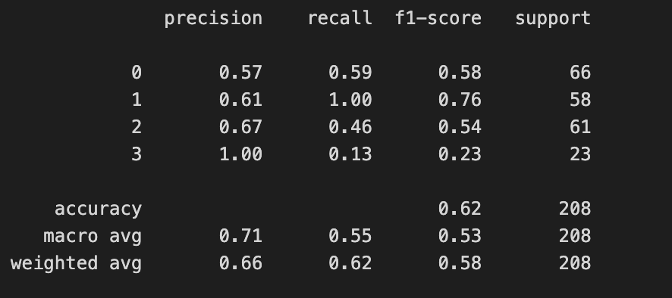
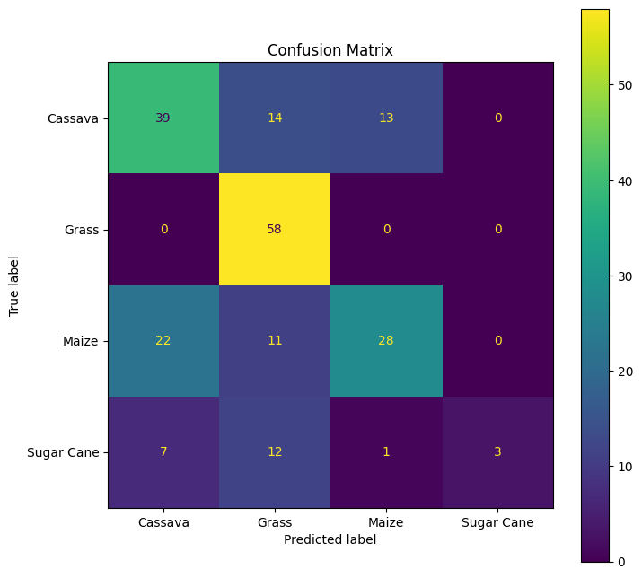
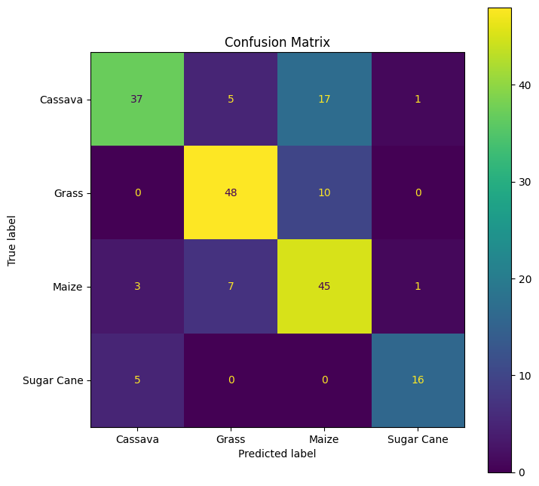
Results NB: Color Hist vs Edge Detection
Color Hist.
Edge Dect.

Slide 10
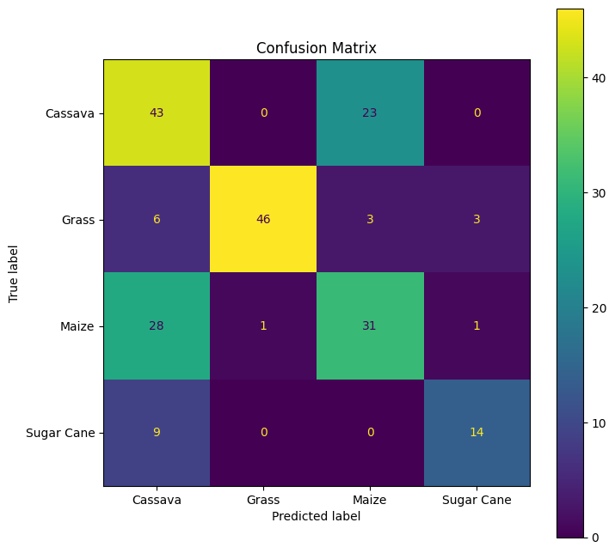
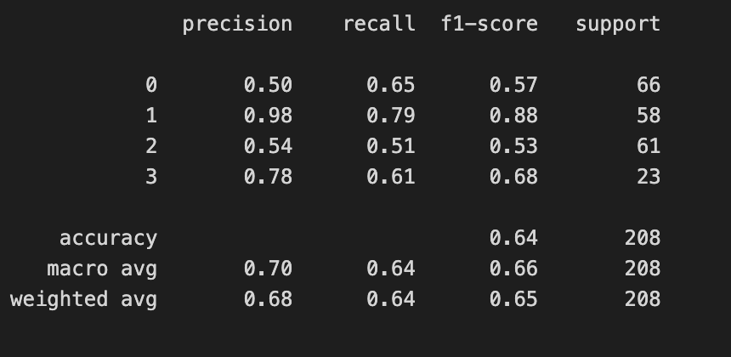
Results NB: Color Hist plus Edge Detection
Classification report
Confusion Matrix

Slide 11
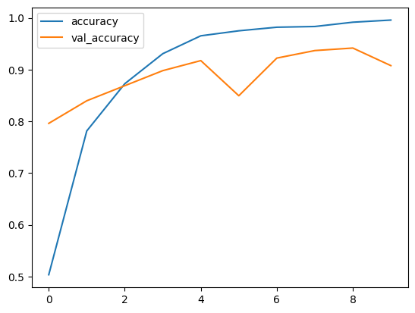
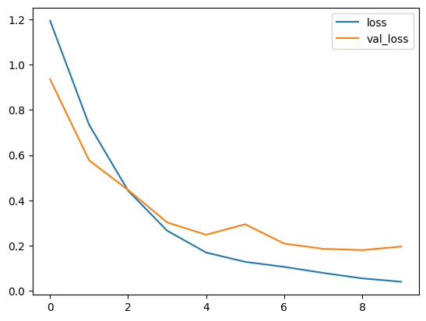
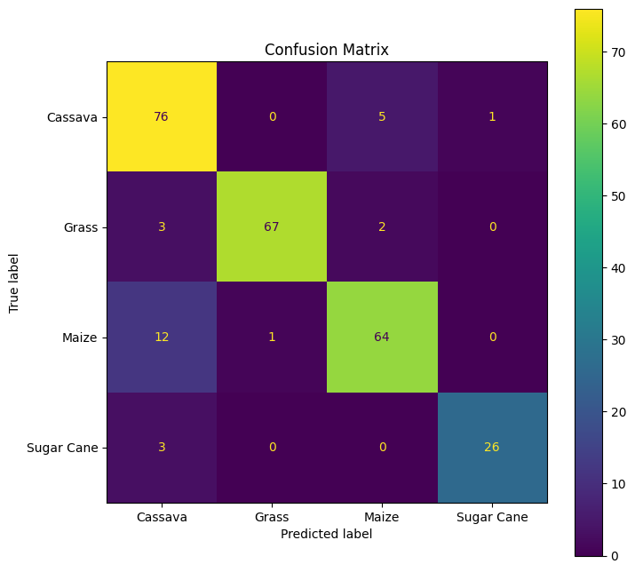
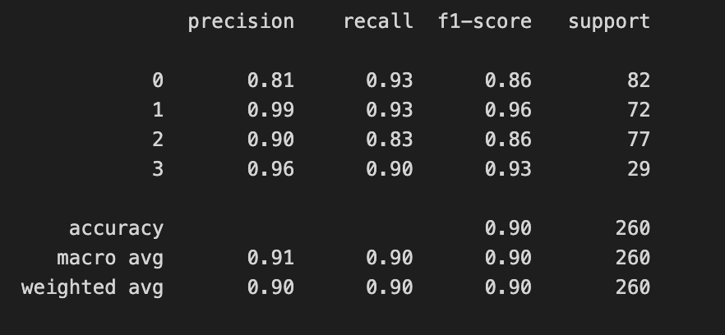
Results: CNN

Slide 12
Results Discussion: Comparative Analysis of Model Performance
Model 1 (Naive Bayes with Edge Detection): Achieved an accuracy of 62%, suggesting edge detection alone may not be sufficient for accurate classification.
Model 2 (Naive Bayes with Color Histogram): Achieved higher accuracy of 75%, indicating the color histogram approach provides more discriminative information for classification.
Model 3 (Naive Bayes with Combined Edge Detection and Color Histogram): Accuracy went to 64%, suggesting the combination of these techniques may not be complementary or may introduce noise.
Model 4 (Convolutional Neural Network): Achieved the highest accuracy of 90%, indicating superior capabilities for feature extraction and classification.
NOTES: Non maximum suppression and image size affect accuracy.
Recommendations:
- Focus on optimizing the color histogram feature extraction technique due to its promising results plus image size matters.
- Given the high accuracy of the CNN model, further investigation into deep learning approaches is recommended.

Slide 13
Conclusion
Machine learning and deep learning models show potential in crop and weed classification.
Feature extraction technique choice significantly impacts model performance.
Color histogram technique yielded better results with Naive Bayes classifier than edge detection.
Combining edge detection and color histogram did not enhance performance as expected.
Convolutional Neural Network (CNN) model achieved highest accuracy, highlighting the power of deep learning.
Future Directions
Optimize parameters of the color histogram technique and explore its variations.
Given the superior performance of the CNN model, further research into deep learning approaches is recommended.
Aim to develop more accurate and efficient models for crop and weed classification, crucial for precision agriculture.

Slide 14
References
[1] ”World population to reach 8 billion this year, as growth rate slows”, news.un.org, (Accessed 1 Jul. 2023).
[2] J. H. Westwood, R. Charudattan, S. O. Duke, S. A. Fennimore, P. Marrone, D. C. Slaughter, and R. Zollinger, ”Weed management in 2050: Perspectives on the future of weed science,” Weed Science, vol. 66, no. 3, pp. 275-285, 2018.
[3] M. Fontanelli, C. Frasconi, L. Martelloni, M. Pirchio, and R. Foster, ”Weed management in autumn fresh market spinach: A nonchemical alternative,” HortTechnology, vol. 25, pp. 177-184.
[4] J. H. Westwood et al., ”Weed management in 2050: Perspectives on the future of weed science,” Weed Science, vol. 66, no. 3, pp. 275-285, 2018.
[5] T. Pun, A. Neupane, R. Koech, ”Quantification Of Root-knot Nematode Infestation In Tomato Using Digital Image Analysis”, Agronomy, vol. 11, no. 12, p. 2372, 2021. https://doi.org/10.3390/agronomy11122372
[6] M. Guzel, B. Turan, ̇I. Kadıog ̆lu, B. S ̧in, A. Basturk, K. Ragab, ”How To Affect the Number Of Images On The Success Rate For Detection Of Weeds With Deep Learn- ing”, Turkish JAF Sci.Tech., vol. 10, no. 8, p. 1441- 1446, 2022. https://doi.org/10.24925/turjaf.v10i8.1441- 1446.5183
[7] Z. Wu, Y. Chen, B. Zhao, X. Kang, Y. Ding, ”Re- view Of Weed Detection Methods Based On Computer Vision”, Sensors, vol. 21, no. 11, p. 3647, 2021. https://doi.org/10.3390/s21113647
[8] Y. Zhang, S. Wang, G. Ji, and P. Phillips, ”Fruit classification using computer vision and feedforward neu- ral network,” J. Food Eng., vol. 143, pp. 167-177.
[9] A. Bakhshipour, A. Jafari, S. Nassiri, and D. Zare, ”Weed segmentation using texture features extracted from wavelet sub-images,” Biosyst. Eng., vol. 157, pp. 1-12, 2017.
[10] L. Pereira, R. Nakamura, G. Souza, D. Martins, and J. Papa, ”Aquatic weed automatic classification using ma- chine learning techniques,” Comput. Electron. Agric., vol. 87, pp. 56-63.

Slide 15
GITHUB LINK
https://github.com/MutegekiHenry/cv-weed-classification

